Slide 1
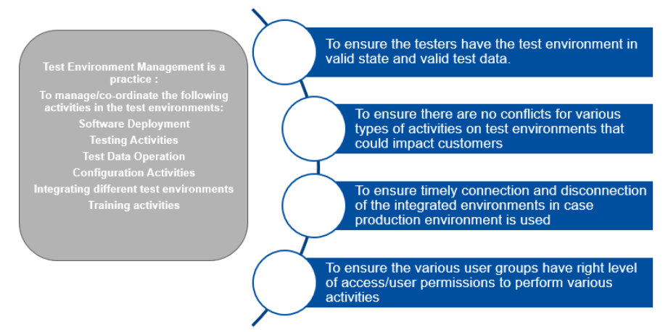
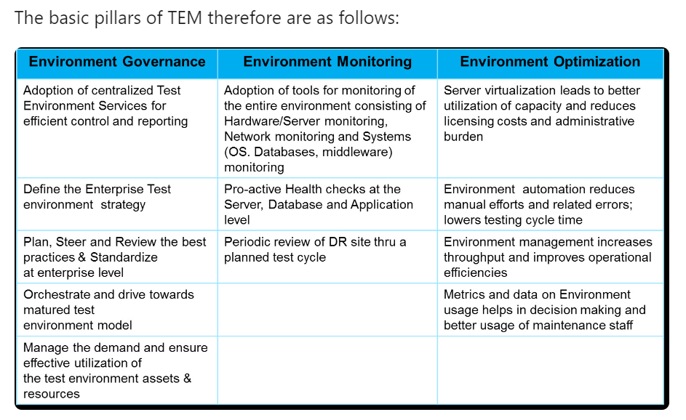
What is Test Environment Management?
Test Environment Management is about controlling, steering and managing the enterprise level test environments. It consists of multiple components like hardware, software, databases, middleware, applications and test data managed by tools, procedures and resources effectively. However with the number of tools increasing by the day, managing test environments is becoming more of a challenge than ever before. It has now dawned upon businesses that managing multiple slow, inconsistent and unreliable test environments will result in higher operational costs and lower test coverage.
is more crucial than ever before. It's the unsung hero that bridges the gap between our software development teams and high-quality outcomes, yet it often doesn't get the spotlight it deserves.
It's the process that ensures all testing environments are stable, consistent, and conducive for precise, accurate software testing. Without effective TEM, we risk encountering issues such as environment drift, data inconsistencies, and miscommunication — issues that can gravely impact our software delivery timeline and product quality.
What Drives Appropriate Test Environment Management? The key factors driving smooth management : 1. The processes for end-to-end testing should be transparent for managing your test environment. : 2. Resource management: Use a resource properly and assign the right task to the right person. 3. Efficient planning: Plan a successful test cycle at each sprint that results in a bug-free end product. 4. Process optimization: Adjust the entire test process in a way that the resources give their best output. 5. Test automation: Automate every repetitive task that seems to waste manual labor.

Slide 2
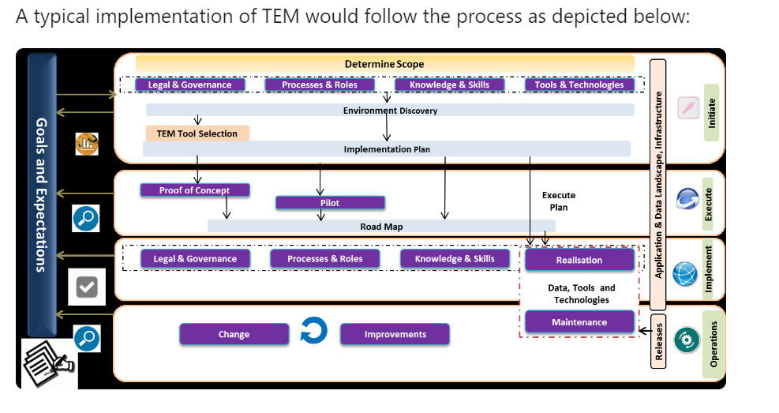
Key test environment challenges : 1. Configuration Issues in Environments 2. No Dedicated Test Environment Team 3. Most of the test environments are fragmented and environment activities are hidden or distributed under testing, infrastructure and development teams. 4. Test Environment assets are not consolidated properly.
5. Few test environment assets are either underutilized or over utilized as there is no tracking mechanism for the assets 6. Releases are project level and not grouped together. 7. Best practices are not defined and implemented 8. None or little documentation and reusable value 9. Most of the activities are manual and no tools are used
Key factors for a successful TEM
1. The key factors for a successful test environment management are summarized below: a. Efficient Resource Management b. Strategic Planning and Robust Program Governance c. Process Optimization and Operations excellence d. Automation
2. 𝗘𝗻𝘃𝗶𝗿𝗼𝗻𝗺𝗲𝗻𝘁 𝗦𝘁𝗮𝗻𝗱𝗮𝗿𝗱𝗶𝘇𝗮𝘁𝗶𝗼𝗻: By ensuring that all testing environments are identical, we can minimize errors due to discrepancies, leading to smoother deployment processes. 3. 𝗘𝗻𝘃𝗶𝗿𝗼𝗻𝗺𝗲𝗻𝘁 𝗕𝗼𝗼𝗸𝗶𝗻𝗴: Reserving environments for specific testing periods can prevent conflicts and ensure that resources are available when needed. 4. 𝗘𝗳𝗳𝗲𝗰𝘁𝗶𝘃𝗲 𝗖𝗼𝗺𝗺𝘂𝗻𝗶𝗰𝗮𝘁𝗶𝗼𝗻: By promoting clear, concise communication across all stakeholders, we can avoid misunderstandings about environment status and availability, ensuring seamless operations.

Slide 3
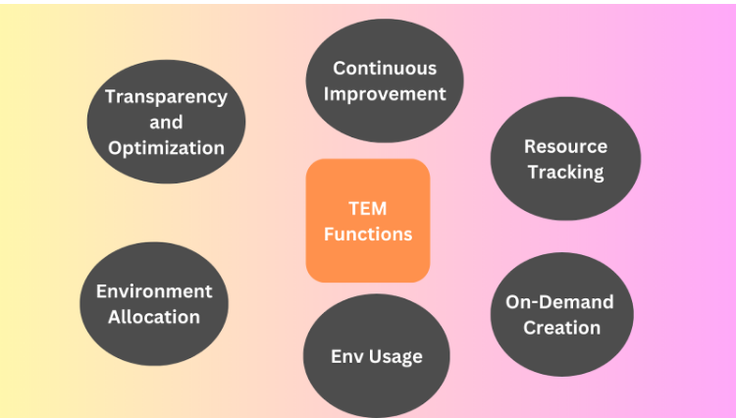
Question to asked : a. How many non-production environments are there to be supported b. Are the environments provisioned on-premises or in the cloud c. Do we have DevOps tool chain implemented - CI/CD d. Are the application deployments automated in both lower environments and in prd e. Do you have automated sanity checks in place across the all applications f. Do we have architectural diagrams for all applications g. Are the test environments shutdown outside of core business hours. f. How frequently are the code refresh done g. Is Application monitoring enabled for all the applications h. Are we using ServiceNow or any other tool for ITSM support set up i. Please share current application landscape
Designation of employees who are deeply involved in TEMS
QA Managers, Engineers and Quality assurance analysts
Release Managers, Coordinators and Leads
Solution Architects
Engineering Managers
DevOps Manager
Team Leads
Project Managers
Directors of Engineering
Every team member can help build an effective test and production environment performance and be a part of a Test environment Management process.
Activities:
The activities under the TEM function include:
Maintaining a central repository of test-environments in scope with their latest version and connectivity details (Information management)
`Allocation of test environments (booking/scheduling) to teams as per requirement. (Demand management)
`Creation of new test environments as per requirement. (Supply management)
`Environment Monitoring (Monitoring)
Deleting/ updating outdated test-environments and its details (Housekeeping)
Preliminary investigation of issues on the environment and sometimes co-ordination till an issue resolution (Incident Management)
Analysing data for environment issues, identifying trends and taking pro-active steps to resolve issues / co-coordinating for a long term fix. (Problem Management)
`Test data management to ensure that test data is available to testers when needed via a TDM tool or test data refresh from other environments
`Status Accounting to report on service, usage, and availability metrics to provide full transparency into test environment management activities
Continuous improvement to continuously evaluate test environment management services for improvement opportunities (people, process, and tools)
`Automation to eliminate manual tasks as much as possible to improve efficiency

Slide 4

Year 1
TeMS team establish Roadmap..
Establish outcomes
Periodic Review
Sign-off
M1
M2
M3
M4
M5
M6
…
M12
Industry Benchmark
TEM & Service Virtualization
Current state evaluation & Assessment
Booking calendar, new environment provisioning, implement resilience solution
Well managed Test environment
TEM Service Catalogue
Environment Cleansing, monitoring alerts, environment control,
TEM metric reporting & ROI calculation
Implementation of TEM solutions for projects, Environment,
automated environment health check
Workforce Transformation
Discovery : Team’s Skill Assessment
Establish Knowledge repository. Develop Upskill and Cross skill plan
Define Skillset
Enable Automation training
Agile Training & certification
Roll out Transformation initiatives to BAU team
Digital Dashboard
Establish Metrics – baseline, benchmark, KPI norms
AI and chat bot enabled digital dashboards with drill down features
Build Digital dashboard, Charts
Tools based metrics collection

Slide 5


